Slide 1
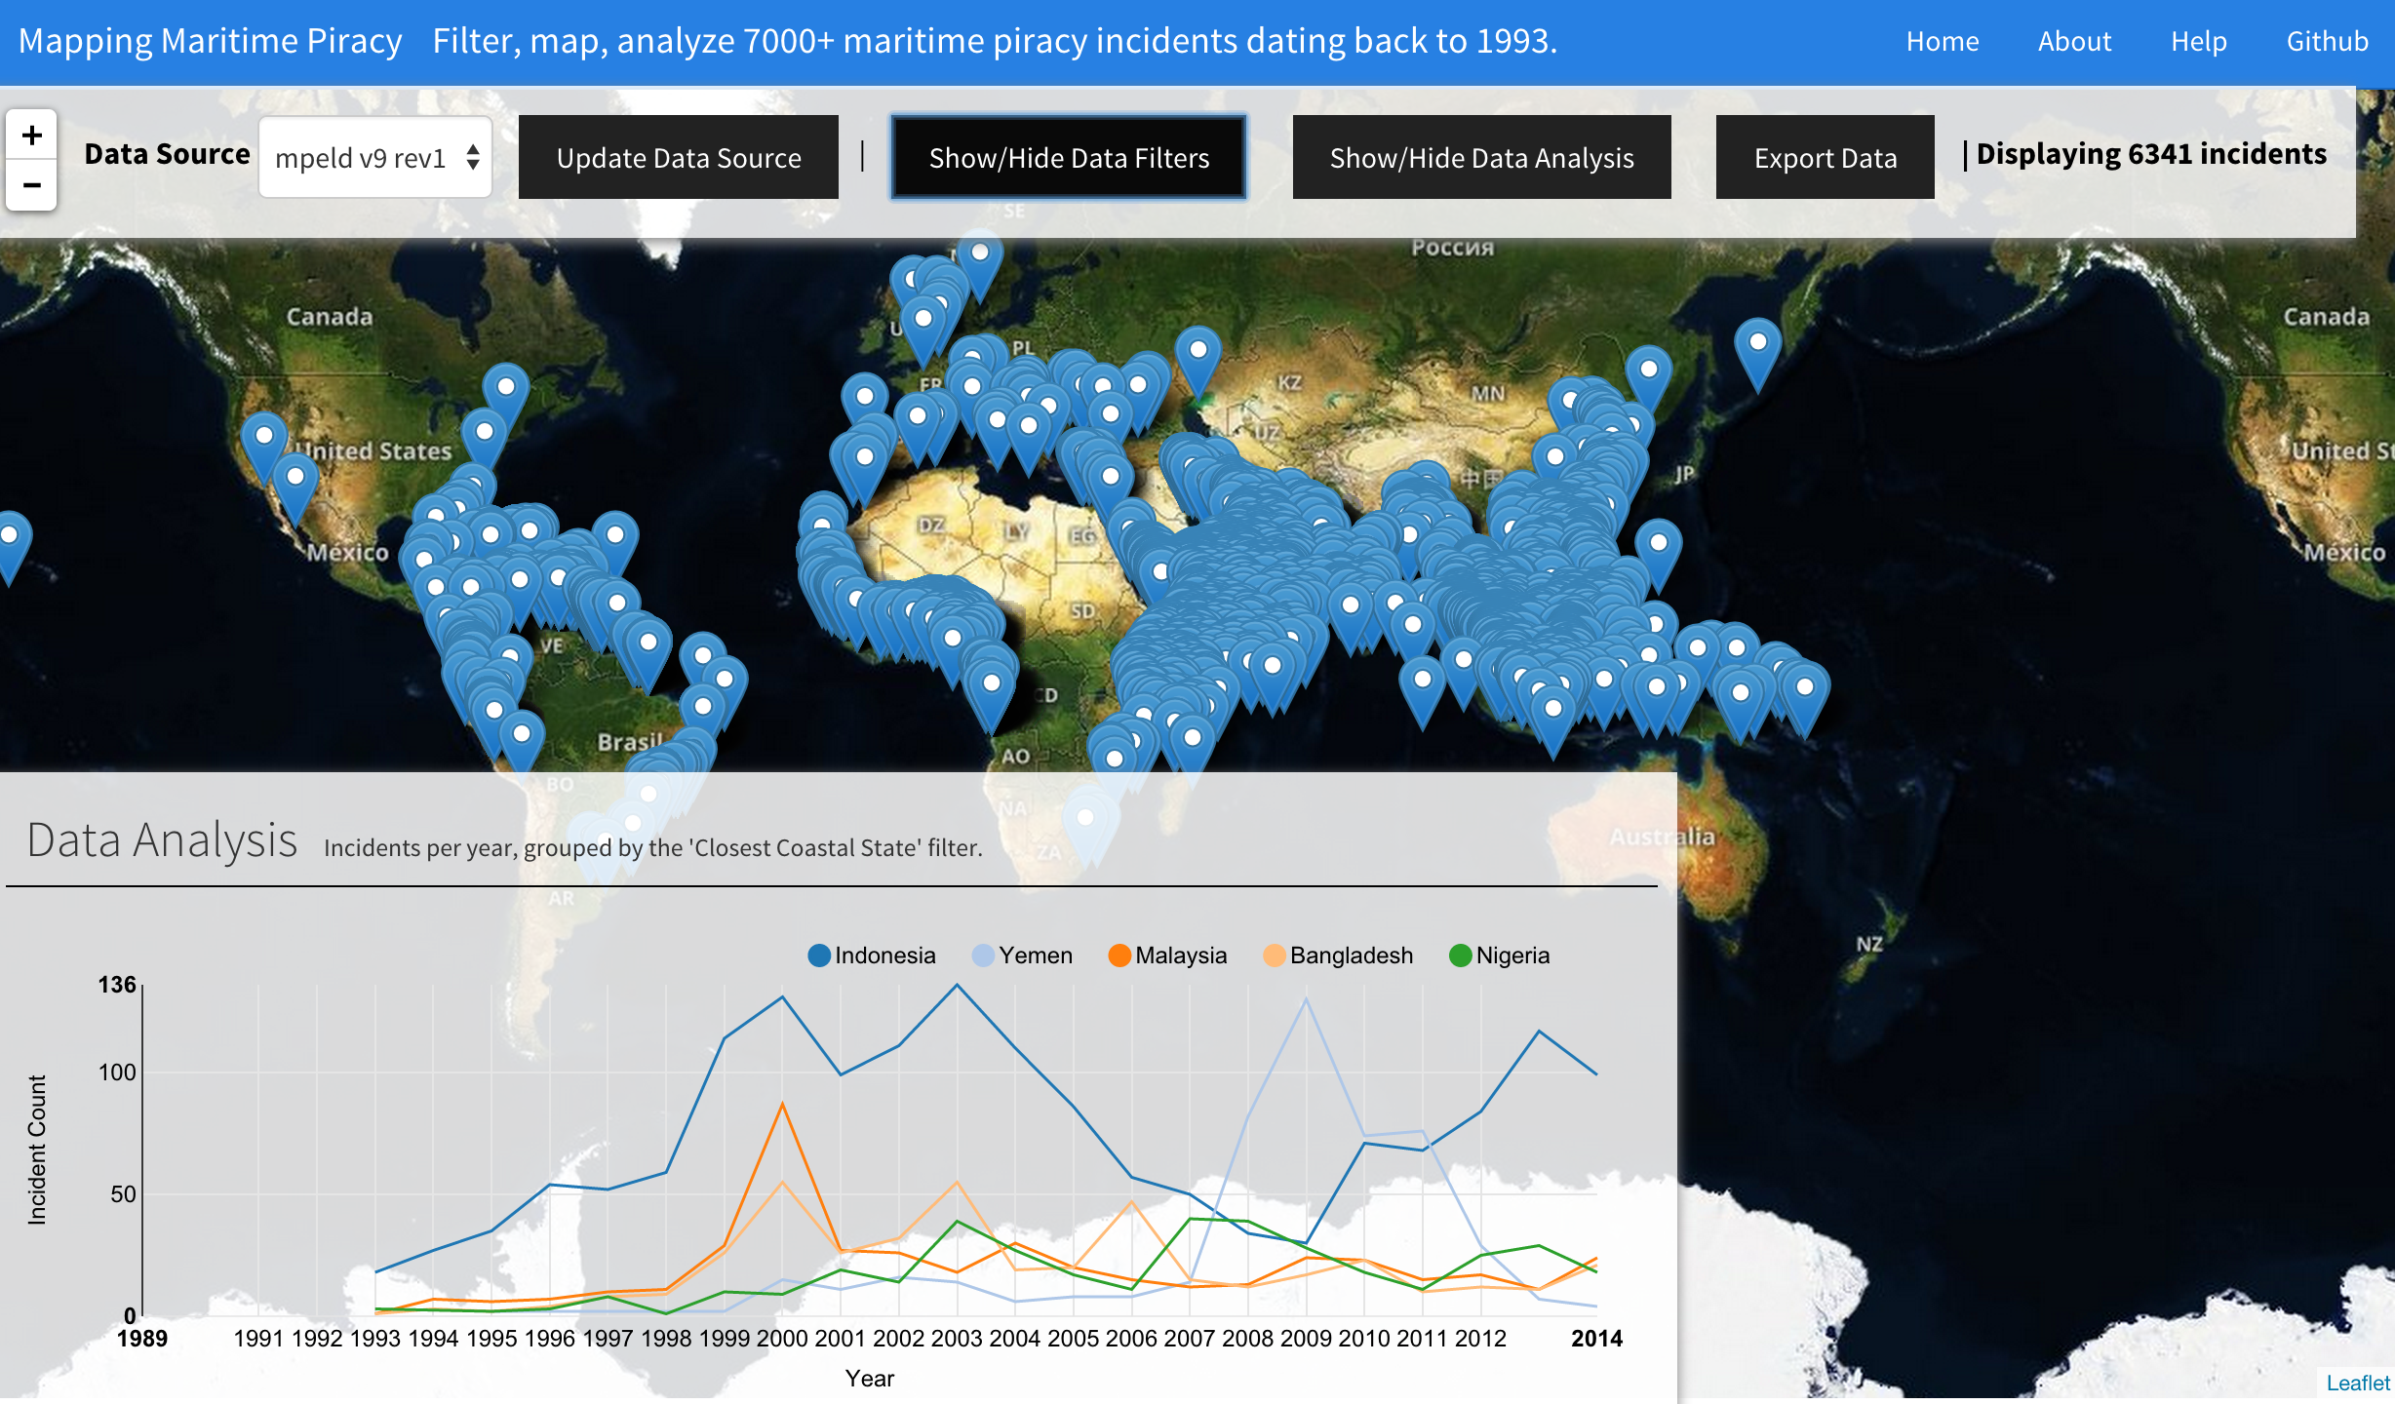
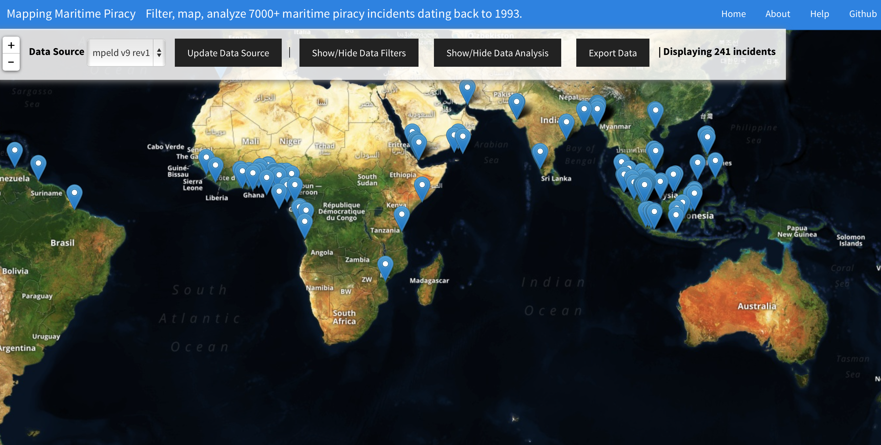
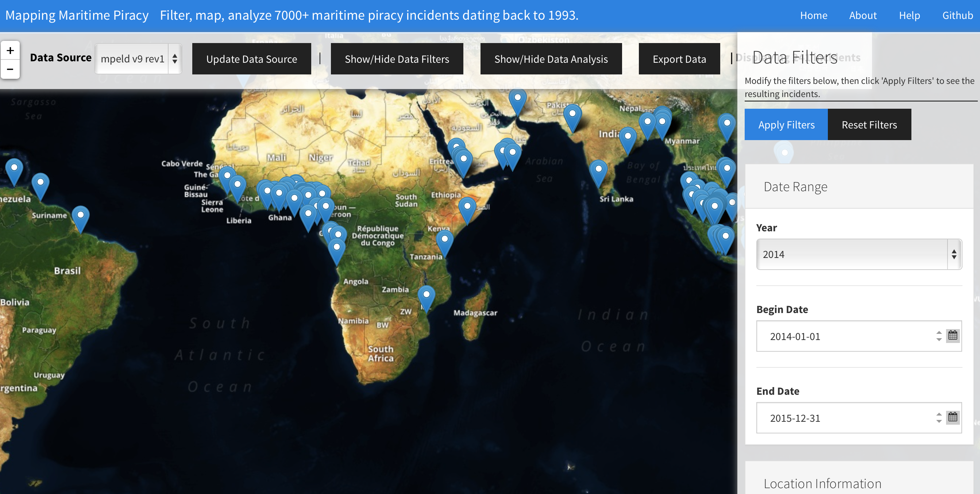
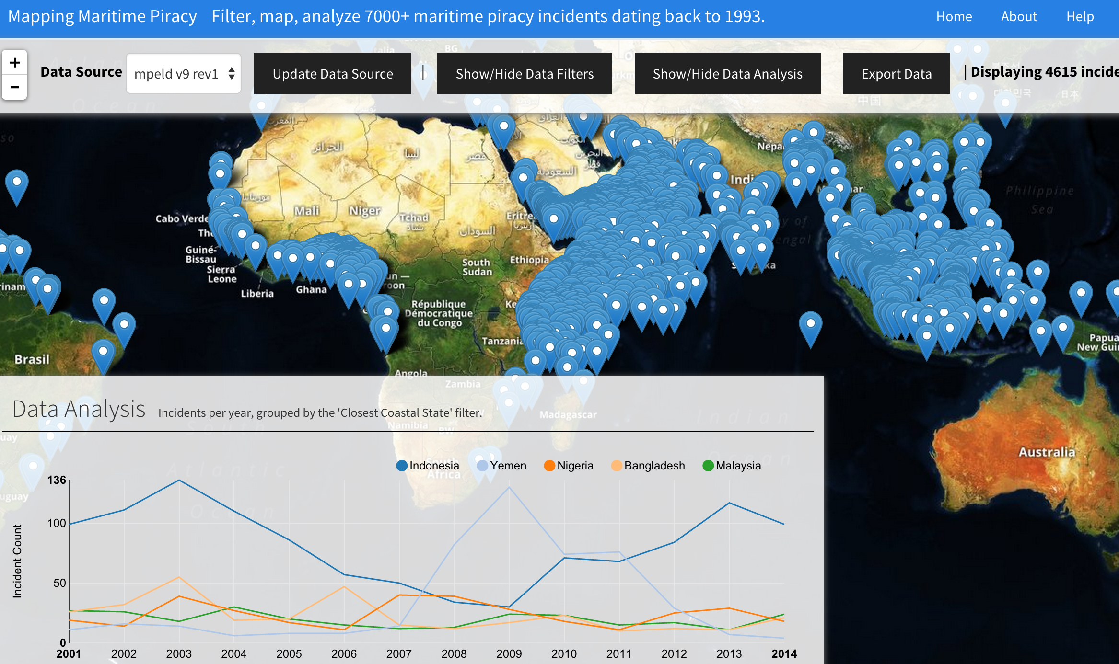
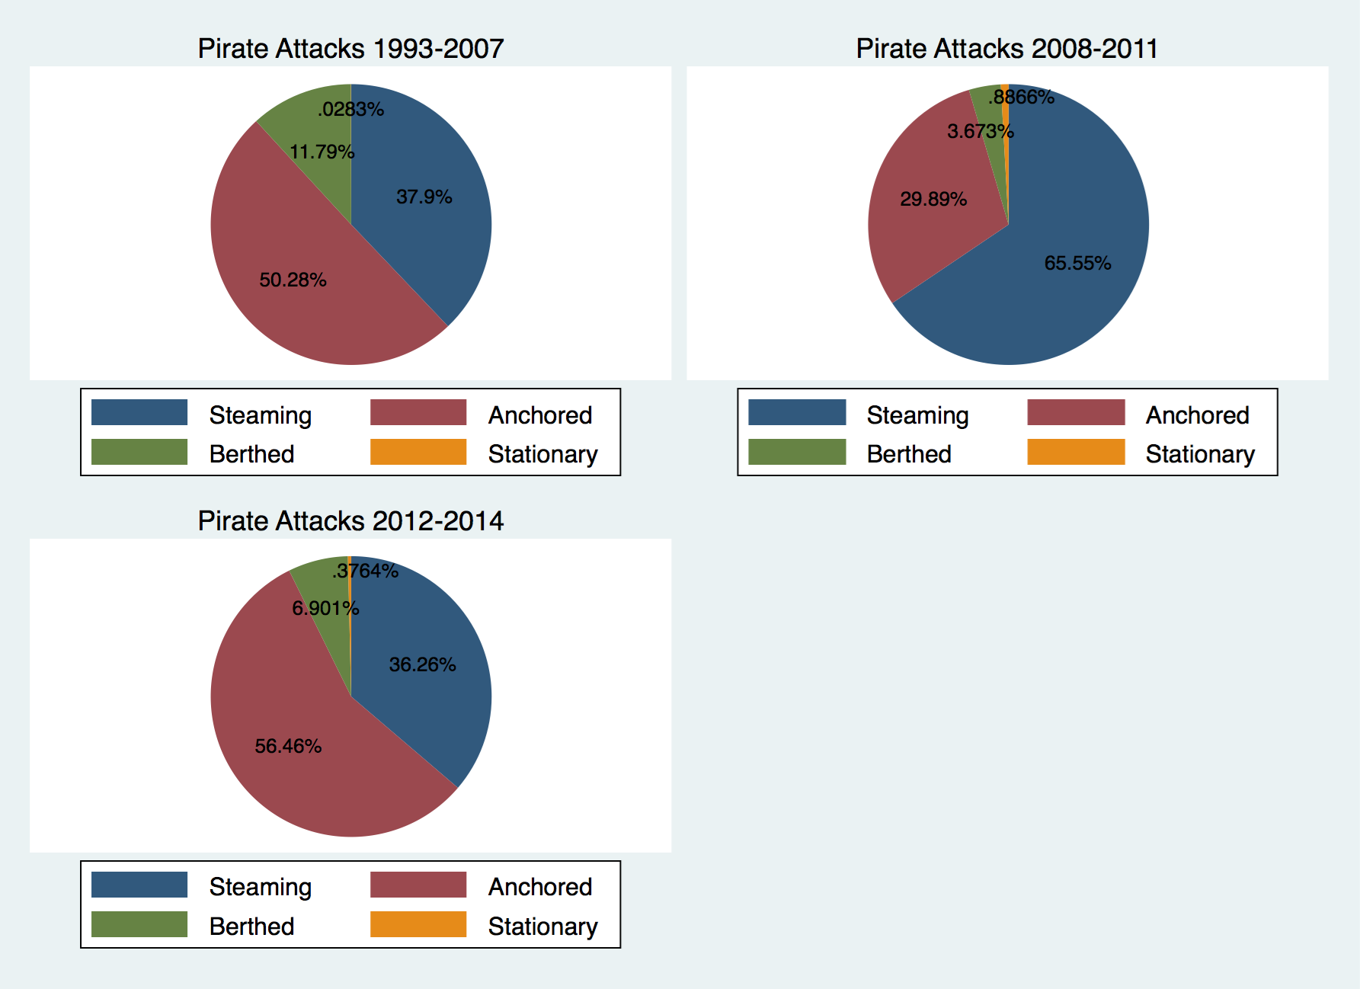
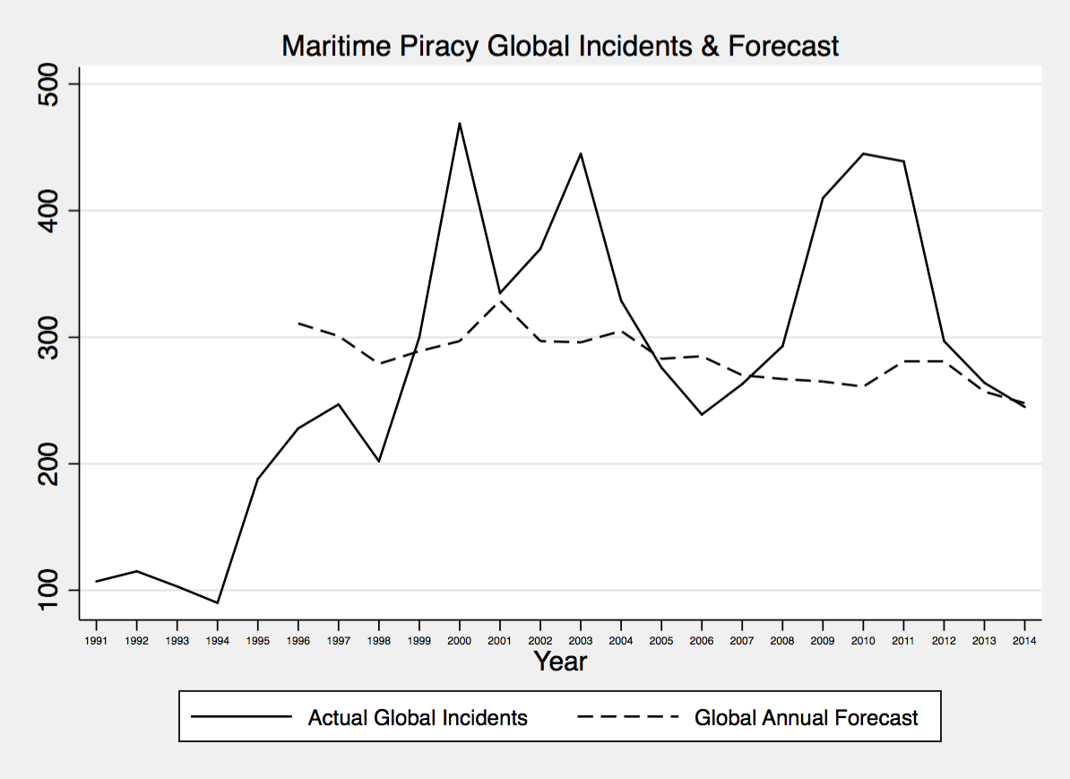
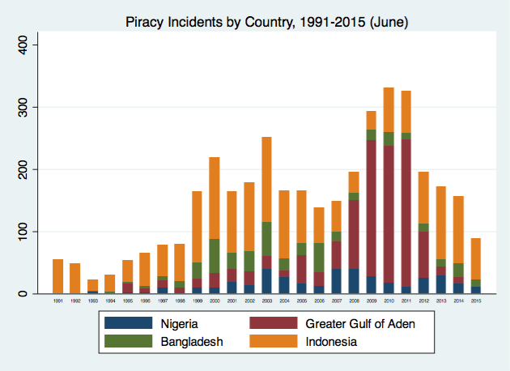
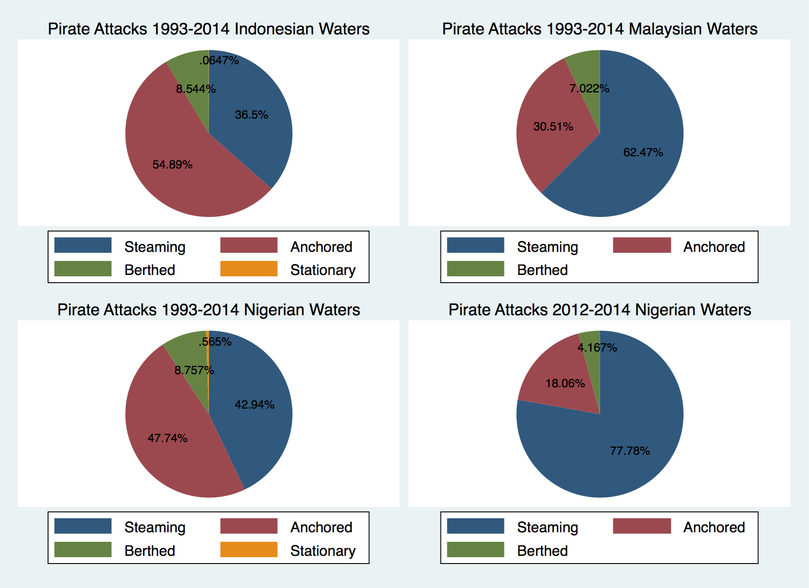
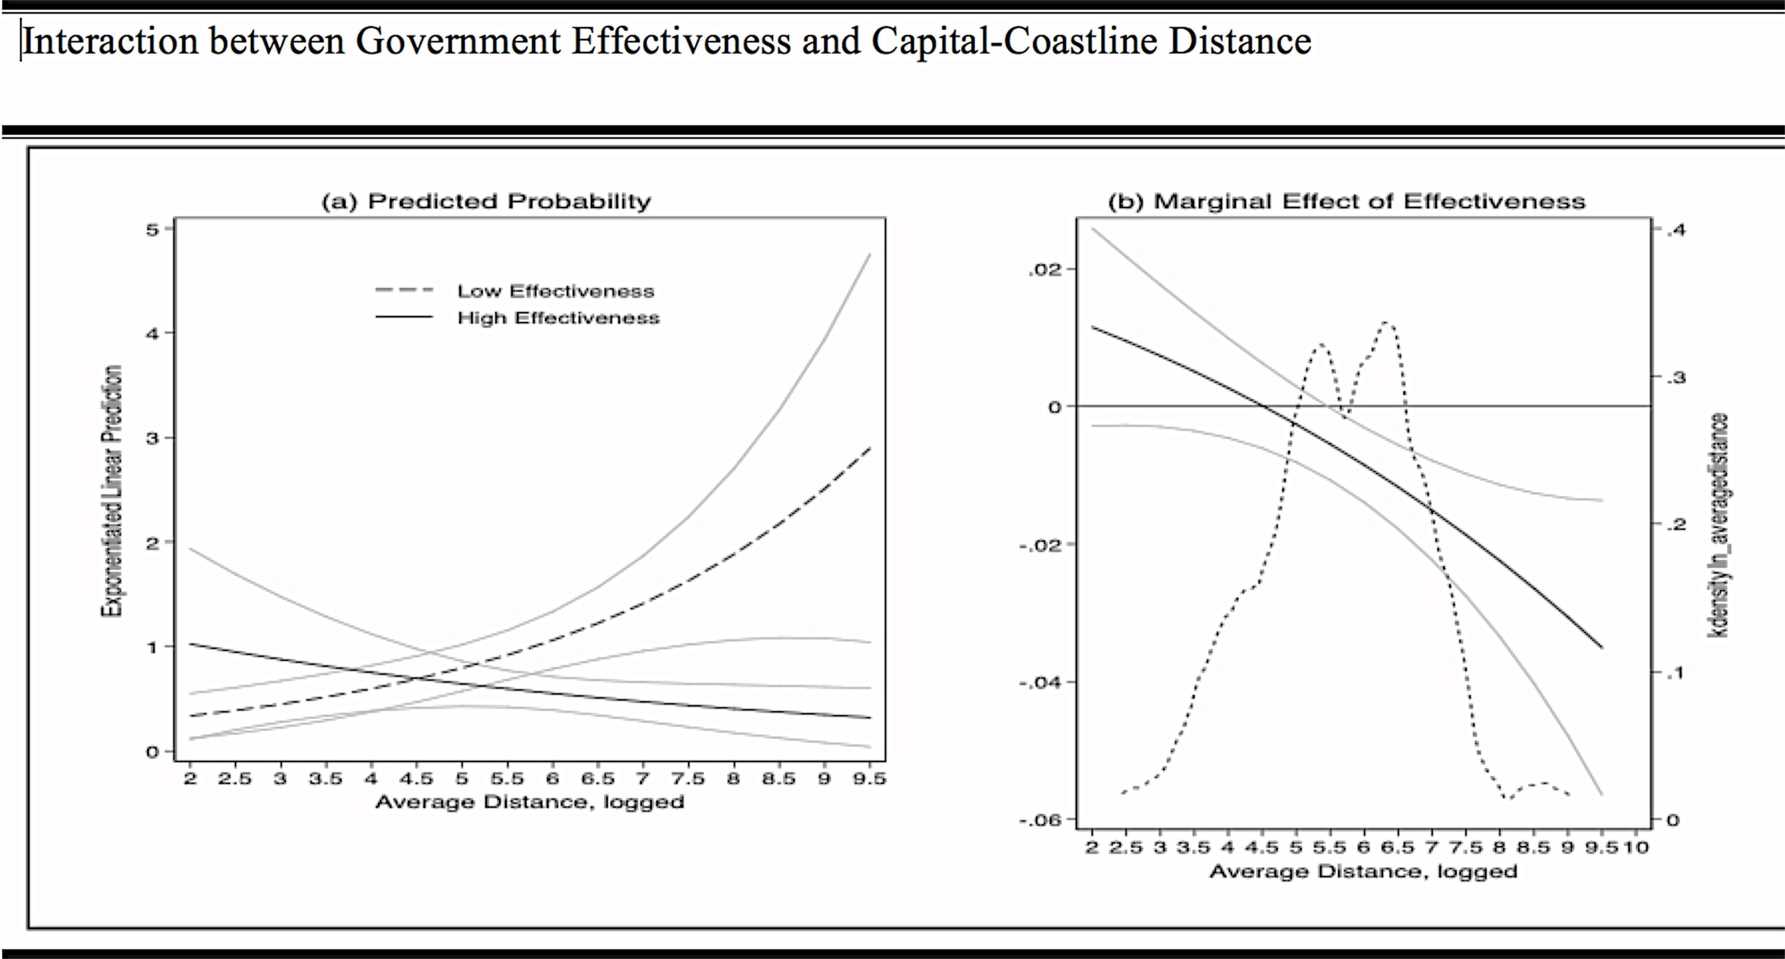
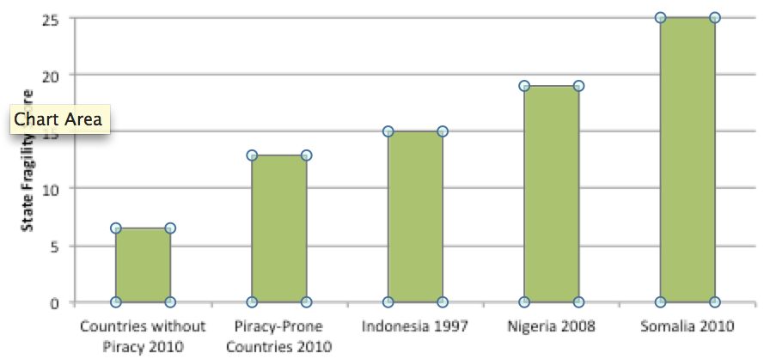
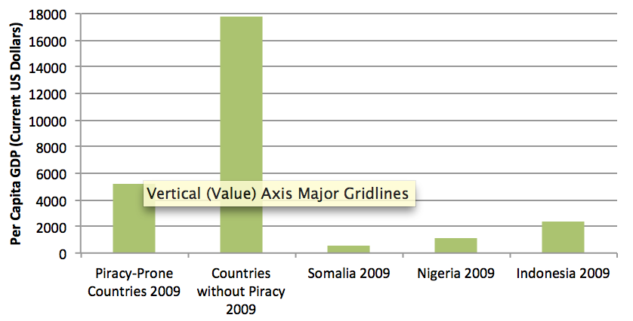
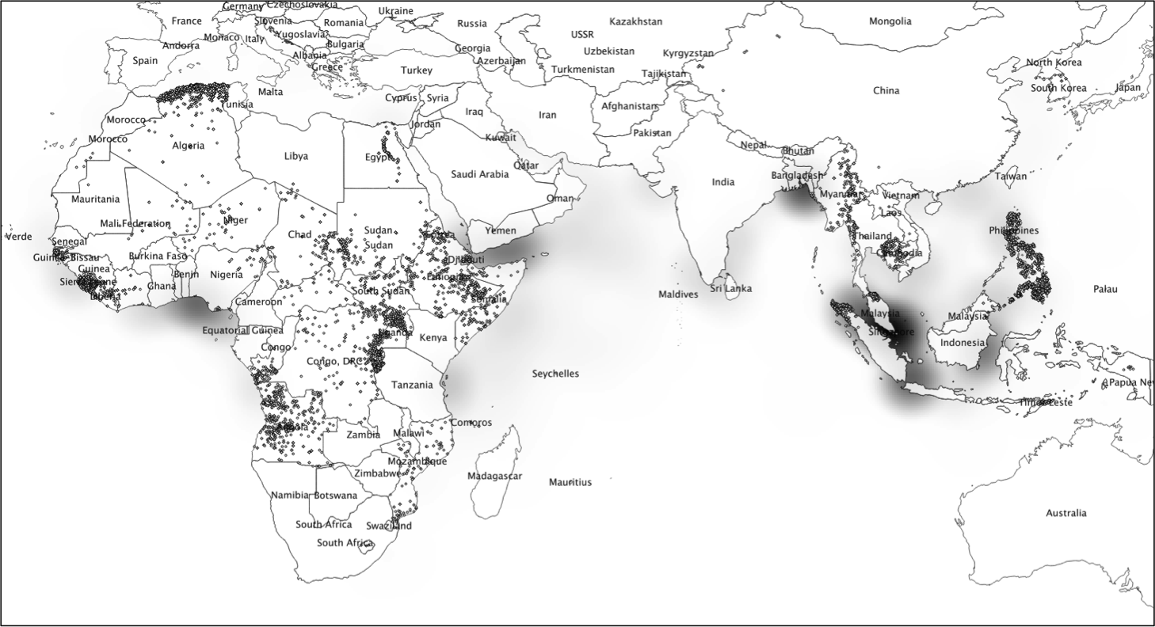
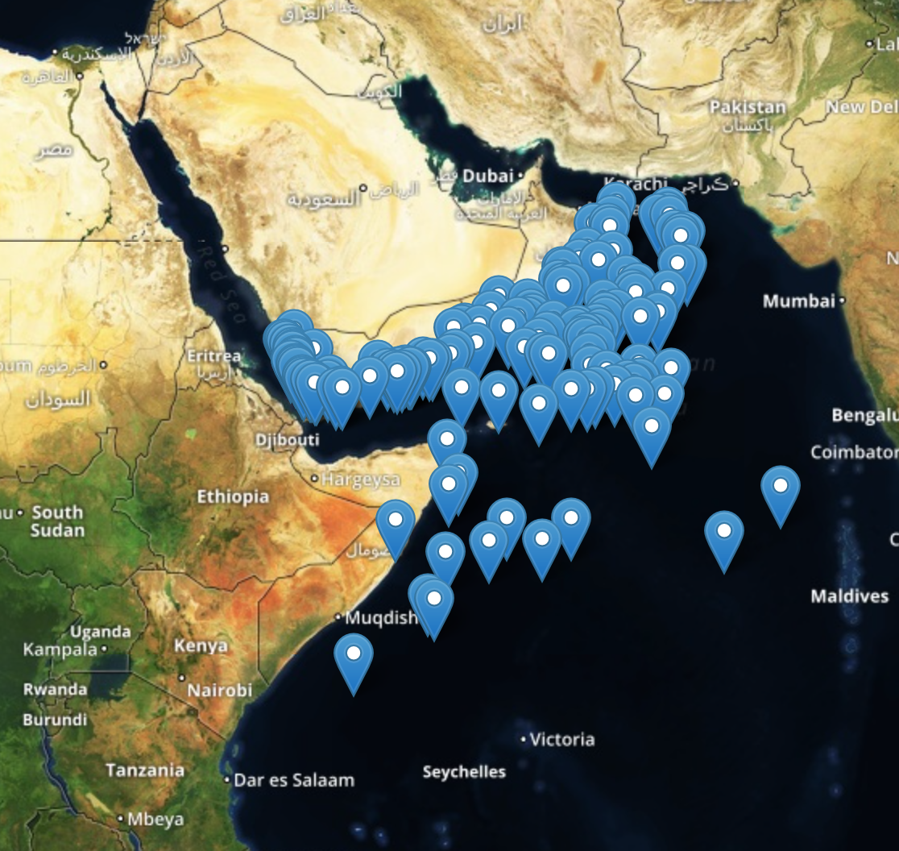
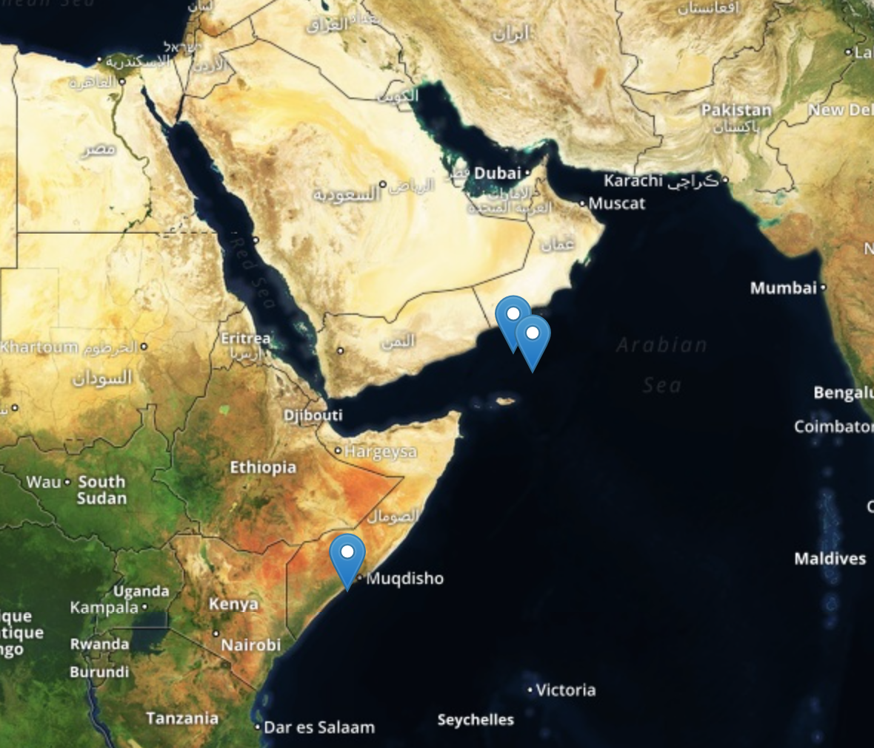
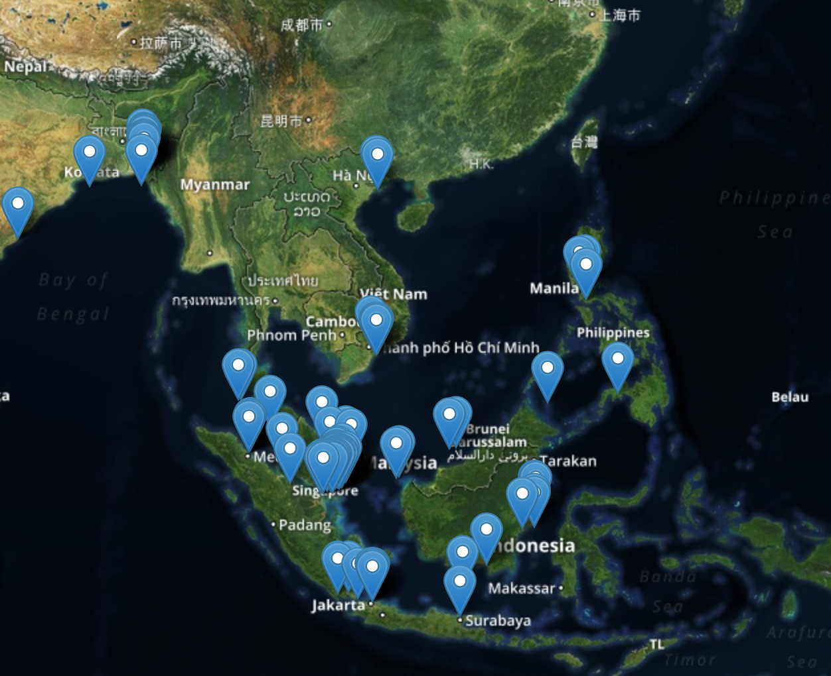
Maritime Piracy Event & Location Data Project Brandon C. Prins – Department of Political Science & Howard Baker Center for Public Policy, University of Tennessee Ursula Daxecker – Department of Political Science, University of Amsterdam
Project Goals
Explore the structural and micro-level drivers of modern maritime piracy
Geo-code all pirate attacks worldwide
Cross-check data against other available data collection efforts (ASAM & IMO)
Build database on pirates and pirate organizations through expert surveys
Build web-based portal to access incident-level data and filter on several piracy characteristics
Dynamically map geo-coded piracy data
Forecast piracy globally and in specific country contexts
Global Maritime Piracy
Online Mapping Application
Pirate Attacks, 1993-2014
MPELD Database
Over 6,300 geo-coded piracy incidents
Currently 1993-2014
Currently inputting 2015
Filters include country, time of day, ship characteristics, whether ship was underway, pirate-specific information.
Beta version of online data portal now available.
Filter incidents by country, date, vessel flag, vessel status when attacked, and success of attack
Can zoom to specific regions or countries
Incident information available by clicking on piracy icons
Over time graphing available by year and country
Option to select piracy data source (IMB, IMO, ASAM)
Exporting of data in tab-delimited format available
Can choose to hide website elements to better visualize piracy incidents
Data will be updated each 6 months
Theoretical Conjectures
Modern maritime piracy driven by opportunity, willingness, and loss of strength gradient.
Fragile and corrupt governing institutions provide opportunity
Poverty, inequality, and overall joblessness provide willingness (grievance)
Physical topography of country interacts with state weakness to produce loss of strength gradient.
Pirates strategically consider loss of strength gradient in their location considerations.
Climatic conditions impact timing of attacks
Piracy connected to insurgent groups as funding source
Shareable Data Created
Global Piracy Incidents Database (GPI) – Data on piracy events recorded at the incident, country-month, and country-year levels. Information on important correlates of piracy also contained in the data-files.
Mapping Pirate Organizations Database (MPO) – Survey data on pirate organizations in four or five piracy-prone countries.
Maritime Piracy Event and Location Dataset (MPELD) – Geo-spatial coding of piracy incidents
Maritime Piracy Mapping Application
Website Link- mappingpiracy.github.io/#/
Key MPELD Findings
Piracy coming from Malaysia more sophisticated than opportunistic piracy in Indonesian waters
Increase in attacks against steaming vessels mostly due to Somali piracy
Large increase in against against steaming vessels in Guinea Gulf
Analytical model forecasts 248 pirate attacks in 2014 (IMB Reported 245)
Heat Map of Piracy and Insurgency
Trends in 2014
Trends in 2015
Global piracy counts down 7% from 2013 and 44% from 2011
Greater Gulf of Aden piracy drops dramatically from 2011 (152 incidents) to 2014 (3 incidents).
Piracy in Indonesian waters doubles from 2011 to 2014
Nigerian piracy increases by over 160% from 2011 to 2013 but drops by 40% in 2014
Bunkering of transport oil now a threat not only in Guinea Gulf waters but SE Asia as well.
Success rate of pirate attacks over 90% in Indonesian waters but only around 50% in the Gulf of Guinea (location of attack important. Only 15% of attacks in Indonesian waters occur while ships are steaming. Over 75% of attacks in Nigerian waters occur while ships are steaming.
Somali Piracy 2011
Somali Piracy 2014
Global piracy counts up 30% in first 6 months of 2015 from 2014
Piracy in Indonesian waters up 37% (and hijackings 50%) in first 6 months of 2015 compared to 2014
Piracy in Vietnamese waters up a staggering 1200% in first 6 months of 2015 compared to 2014
Piracy in Filipino waters up 150% in first 6 months of 2015 compared to 2014
Hijackings up 130% in Malaysian waters in first 6 months of 2015 compared to 2014
Piracy in waters of Nigeria and Bangladesh up 10% in first 6 months of 2015 compared to 2014
SE Asian Piracy 2011
SE Asian Piracy 2014

