Slide 1
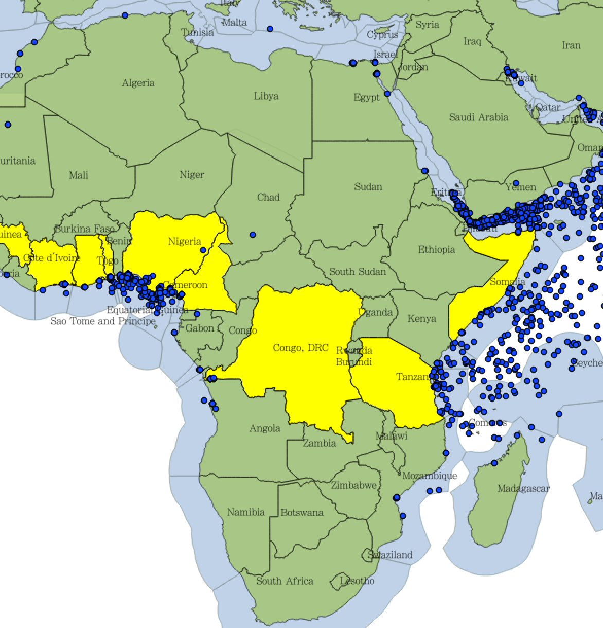
Political Reach, State Fragility, and the Incidence of Maritime Piracy: Explaining Piracy and Pirate Organizations, 1993-2016 - Brandon Prins, University of Tennessee - Ursula Daxecker, University of Amsterdam
Objective
Explore the relationship between government stability, geo-spatial conditions,
and maritime piracy.
Approach
Information from IMB geo-coded and mapped from 1991-2016.
Information on each piracy event recorded
Interview small number of experts in several piracy–prone countries to build database on pirates and pirate organizations.
Attempt to forecast piracy incidents at the country-level using analytical model and geo-coded data.
Accomplishments
Initial geo-coded shape-file created, 4 manuscripts produced, and a technical report completed.
Presentation given to Strategic Multilayer Assessment Program on piracy in Sub-Saharan Africa.
Impact/Transition
We have clearly demonstrated structural relationship between state fragility, political reach, and maritime piracy.
Currently assessing connections between piracy and rebel insurgencies in all littoral countries.

